Slide 1
BIFX 551 Advanced Data Analytics Programming with R
Week 12 – R Shiny

Slide 2
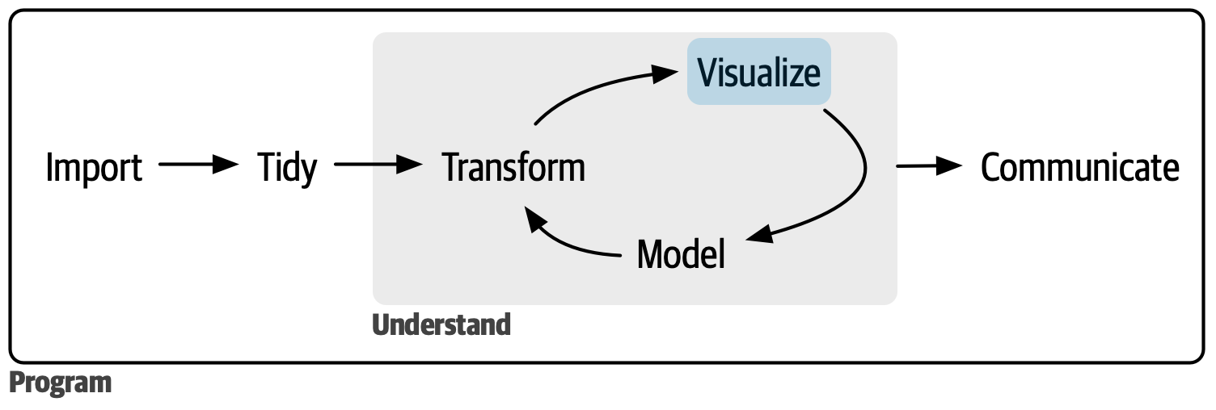
The Data Science Process
Import
  Loading Data in R
Tidy
  Storing and arranging the data in a meaningful way
Transform
  Narrowing the data to the useful bits
  Sometimes this means creating derived elements
Visualize
  This allows you to inspect the data in more meaningful way that numbers may not provide
  Allows to you to ask / find fundamental information about your data
Model
  Generic mathematical representation of your data
  Can be used to predict as well as find outliers
Communicate

Slide 3
What will we cover today?
Basic structure of a Shiny App
Basic examples of Shiny Apps ( Shiny Gallery )
How to navigate https://www.shinyapps.io/
How to setup Rstudio to use https://www.shinyapps.io/
Build a basic applications
Discuss advanced topics
Discuss final project

Slide 4
What is a Shiny Package
Shiny is an R package that allows you to build interactive web applications
There are several extension packages to Shiny
  shinythemes, shinydashboard, shinyjs, etc.
Web apps can be deployed on shinyapps.io or your own server
Many code examples to get you going can be found at https://shiny.rstudio.com/gallery
Code found at
https://github.com/rstudio/shiny-examples/tree/main

Slide 5
Structure of a Shiny web App
Comprised of 3 components:
  User interface (ui.R)
  Server Function (server.R)
  shinyApp function (fuses together the UI and server components)
The UI is the frontend that accepts the user input and displays output
The Server is the backend that processes these inputs to produce an output to give back to the UI
User Input
UI
Server
Process/Analyze Input to
generate output
Display Output

Slide 6
Reactivity
Shiny is built around reactivity
  This means that as input is changed, that change is seen by the application and is sent to generate new output without needing to send it explicitly
Reactivity can be stopped with the use of the isolate() function
  Would be useful if processing a large dataset or downloading a file.
https://shiny.posit.co/r/articles/build/reactivity-overview/

Slide 7
Shinyapps.io
Basic overview of interface
Setup rstudio to use

Slide 8
Shiny Examples
FirstApp
  Reactive input textbox which renders text
Zip codes
  Reactive sliders to do the dbScan on our zip codes dataset

Slide 9
Advanced topics
A great reference book can be found at
https://mastering-shiny.org/
Layout
  https://mastering-shiny.org/action-layout.html
Clicking
  https://mastering-shiny.org/action-graphics.html
Uploads and downloads
  https://mastering-shiny.org/action-transfer.html

